Slide 1
Customer Shopping Behavior Analysis
Uncovering insights from transactional data for strategic business decisions.

Slide 2

Project Overview & Data
Project Goal
Analyze 3,900 purchases to understand spending, segments, preferences, and subscriptions.
Dataset Summary
Rows: 3,900
Columns: 18
Key Features: Demographics, Purchase Details, Behavior
Missing Data: 37 values in Review Rating

Slide 3
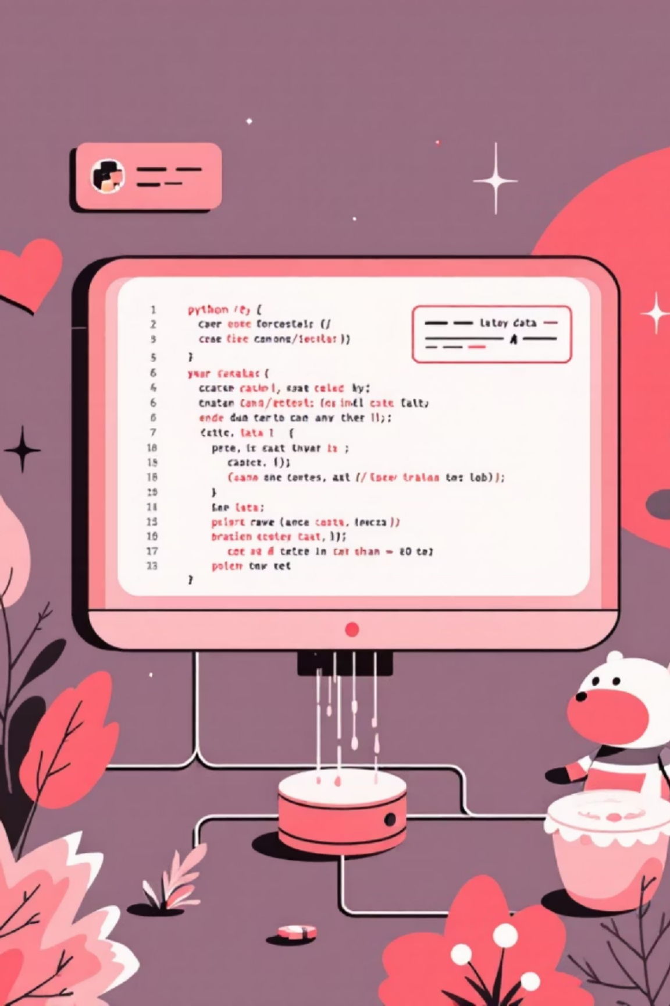
Exploratory Data Analysis (Python)
1
2
Data Preparation
Feature Engineering
Loading, initial exploration, and handling missing values.
Created age groups and purchase frequency.
3
Consistency & Integration
Verified data, dropped redundancy, loaded into PostgreSQL.

Slide 4


Key SQL Insights: Revenue & Discounts
High-Spending Discount Users
839 customers used discounts but spent above average.
Revenue by Gender

Slide 5
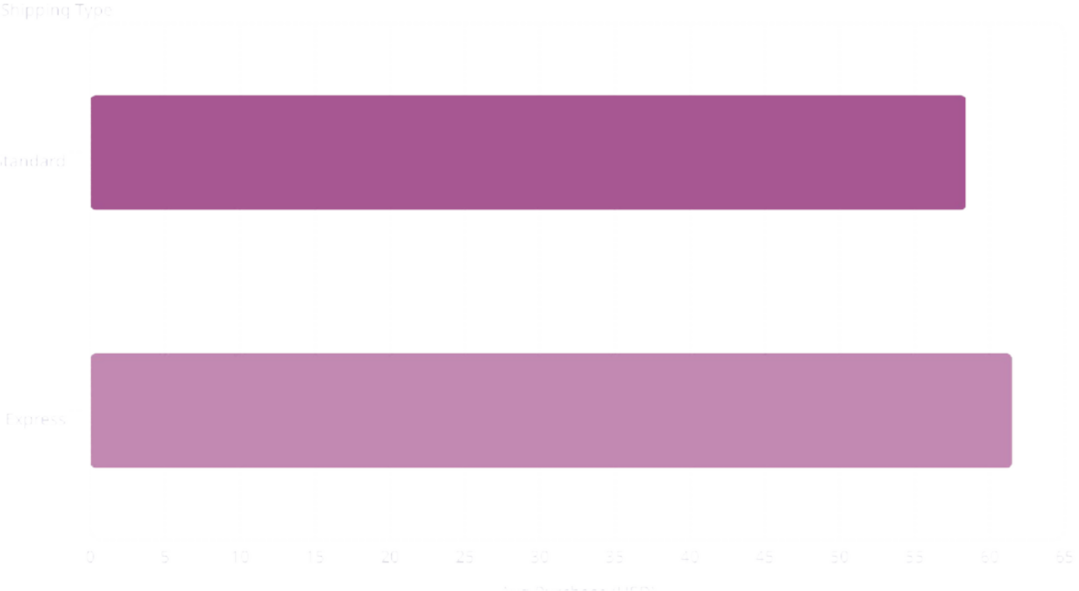
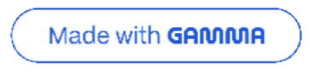
Key SQL Insights: Products & Shipping
Top 5 Products by Rating
Shipping Type Comparison
Gloves | 3.86
Sandals | 3.84
Boots | 3.82
Hat | 3.80
Skirt | 3.78

Slide 6



Key SQL Insights: Subscriptions & Discounts
Subscribers vs. Non-Subscribers
Discount-Dependent Products
Avg Spend (USD)
Total Revenue (USD)
Top 5 products with highest percentage of discounted purchases:
Hat: 50.00%
Sneakers: 49.66%
Coat: 49.07%
Sweater: 48.17%
Pants: 47.37%

Slide 7

Key SQL Insights: Customer Segmentation
Loyal
New
3116 Customers
83 Customers
Returning
701 Customers

Slide 8
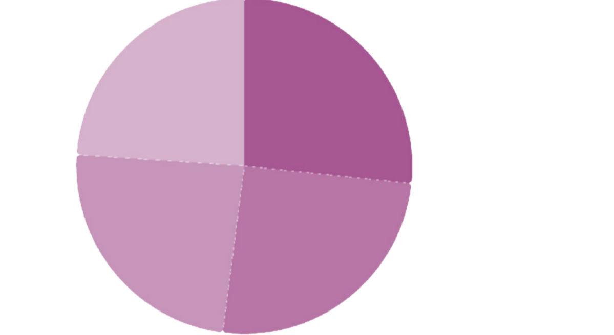




Key SQL Insights: Product & Age
Top 3 Products per Category
Revenue by Age Group
Accessories: Jewelry, Sunglasses, Belt
Clothing: Blouse, Pants, Shirt
Footwear: Sandals, Shoes, Sneakers
Outerwear: Jacket, Coat
Young Adult·2·2·66.6.66%% Middle-aged·2·25· 5.4.4%% Adult··2· 4..02% Senior··2· 3..92%

Slide 9
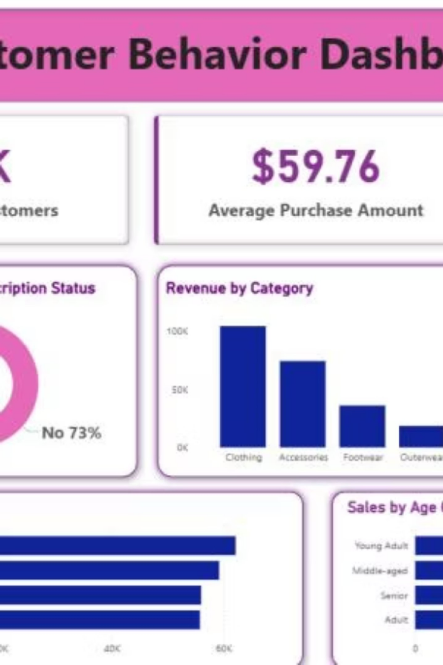
Power BI Dashboard
Interactive dashboard for visual insights:
Customers: 3.9K • Avg. Purchase: $59.76 • Avg. Rating: 3.75

Slide 10





Business Recommendations
Boost Subscriptions
Promote exclusive benefits.
Customer Loyalty
Reward repeat buyers.
Review Discount Policy
Balance sales with margin.
Targeted Marketing
Focus on high-revenue groups.

